Slide 1
Transnational Meeting no. 4 Krsko (Slovenia)
AIJU: main latest tasks (from 3rd meeting)
Supporting School partners in the Basic drone.
Selection of new components for Advanced drone.
Selection & assembly the mini-drone for the wind tunnel.
Creating videos for Droneteam Youtube Channel.
Review Google Drive. Uploading files related.
Designing First Droneteam flyer.

Slide 2
Transnational Meeting no. 4 Krsko (Slovenia)
AIJU: main next tasks (until 5th meeting)
Supporting School partners in the Advanced drone & new works related.
Writing & Finishing the first three Intellectual Outputs (February 2017). Working in next Intellectual Outputs. Working in English Glossary related.
Supporting wind tunnel tests.
Disseminating in official channels (webpage, fb, twitter, YouTube, flyers, etc.)
Supporting Coordinator in Interim Report & Mobility Tool+

Slide 3
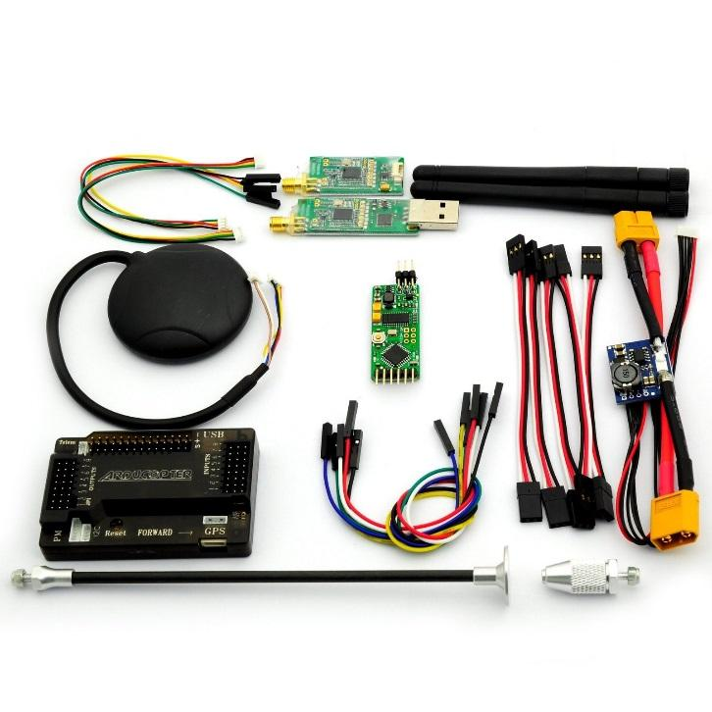
Transnational Meeting no. 4 Krsko (Slovenia)
AIJU: New Components

Slide 4
COMPONENT | BASIC DRONE | ADVANCED DRONE
Flight Controller | CC3D | APM 2.6
Accelerometer | YES | YES
Gyroscope | YES | YES
Telemetry | YES | YES
Barometer | NO | YES
GPS | NO | YES
Magnetometer | NO | YES
Battery Monitoring | NO | YES
Maximum engines | 6 | 8

Slide 5
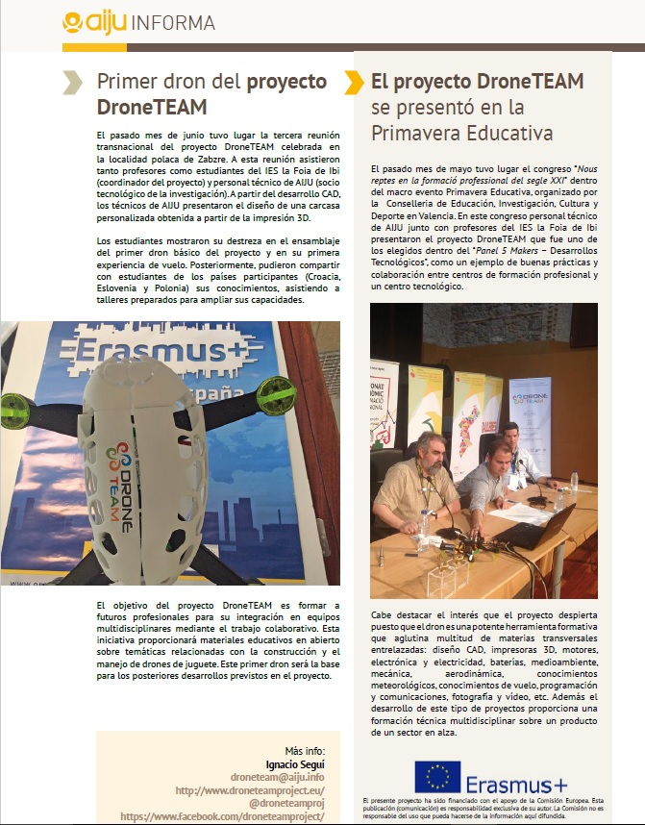
Transnational Meeting no. 4 Krsko (Slovenia)
AIJU’s Dissemination
AIJU’s newsletter:
Informa 101 – June/July 2016:

Slide 6
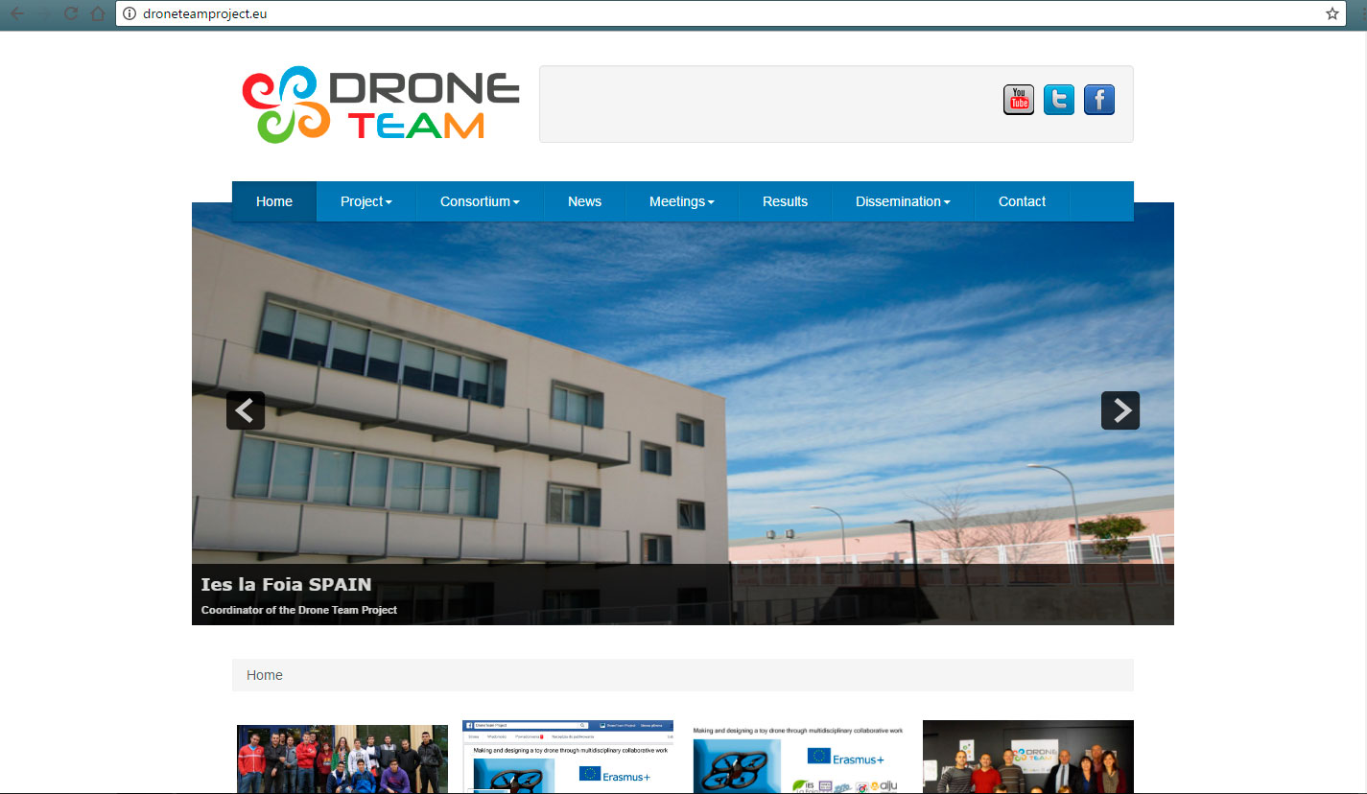
Transnational Meeting no. 4 Krsko (Slovenia)
AIJU’s Dissemination
Website & Social Media (Facebook, Twitter, Youtube)

Slide 7

Transnational Meeting no. 4 Krsko (Slovenia)
AIJU’s Dissemination
Website & Social Media (Facebook, Twitter, Youtube)

Slide 8

Transnational Meeting no. 4 Krsko (Slovenia)
AIJU’s Dissemination
Website & Social Media (Facebook, Twitter, Youtube)

Slide 9
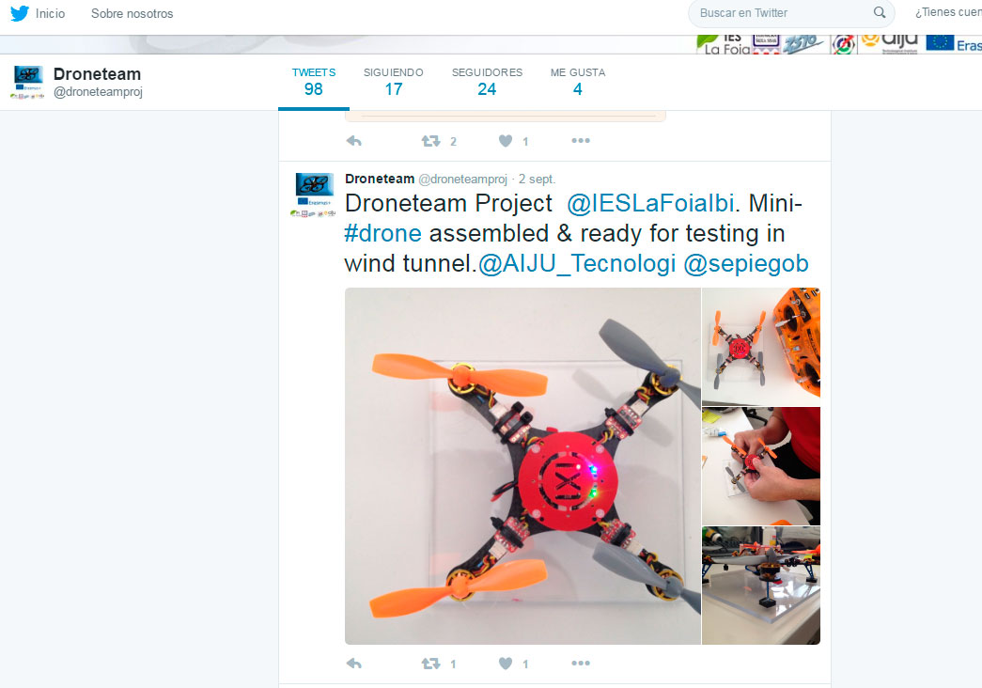
Transnational Meeting no. 4 Krsko (Slovenia)
AIJU’s Dissemination
Website & Social Media (Facebook, Twitter, Youtube)

Slide 10
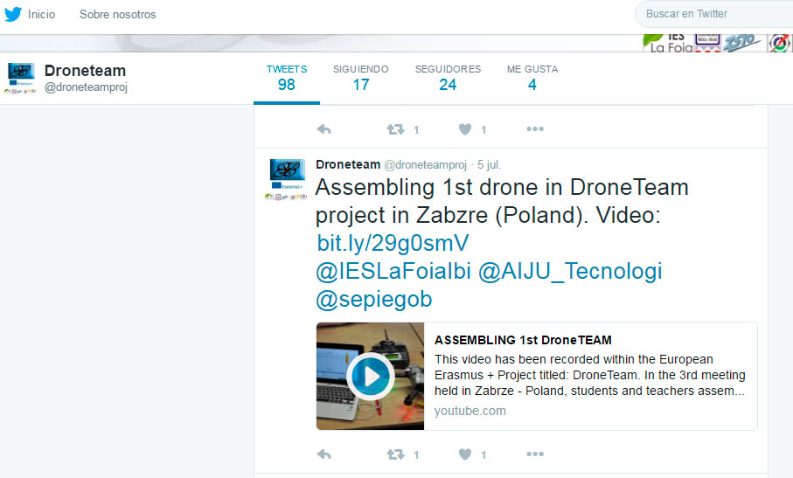
Transnational Meeting no. 4 Krsko (Slovenia)
AIJU’s Dissemination
Website & Social Media (Facebook, Twitter, Youtube)

Slide 11
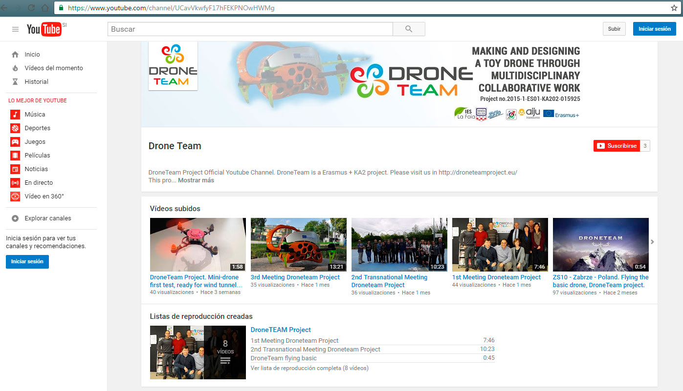
Transnational Meeting no. 4 Krsko (Slovenia)
AIJU’s Dissemination
Website & Social Media (Facebook, Twitter, Youtube)

Slide 12

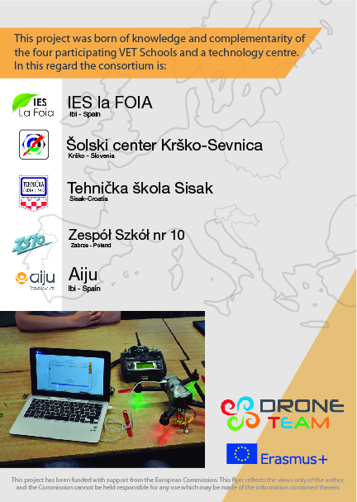
Transnational Meeting no. 4 Krsko (Slovenia)
AIJU’s Dissemination
Droneteam flyer:

